Slide 1
Cricket League and Teams

Slide 2
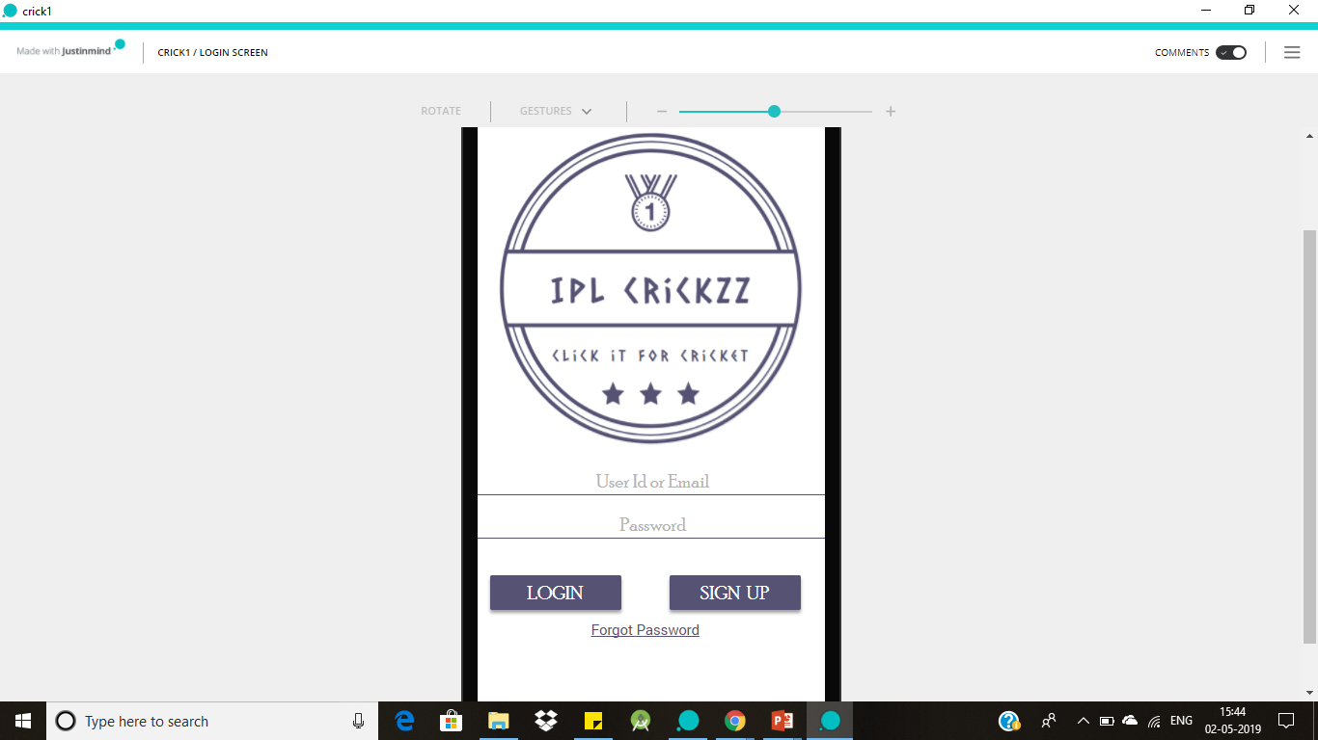
Login Screen
This Screen allows the user to create an account in the application and once the account is created user can be able to login into the application using login credentials.
If the user forgot the application credentials using forgot Password option they can retrieve the account.

Slide 3
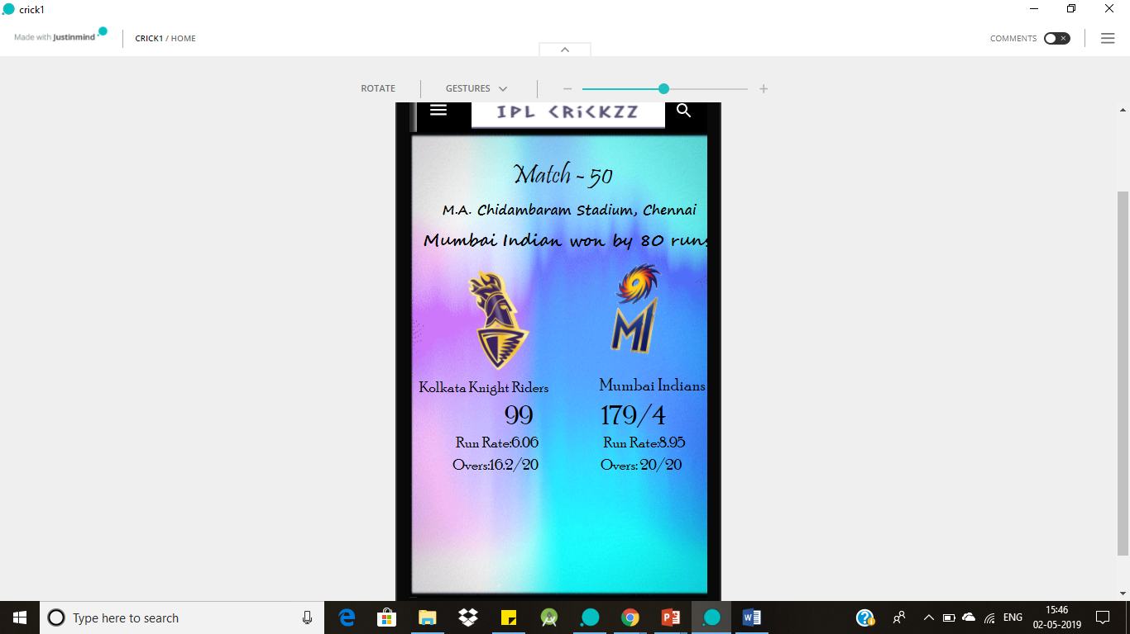
Home Screen
On Home Screen we can see the league matches schedule and live score of the ongoing match. In a short way we can say all the updates of the league can be seen on the Home Screen.

Slide 4
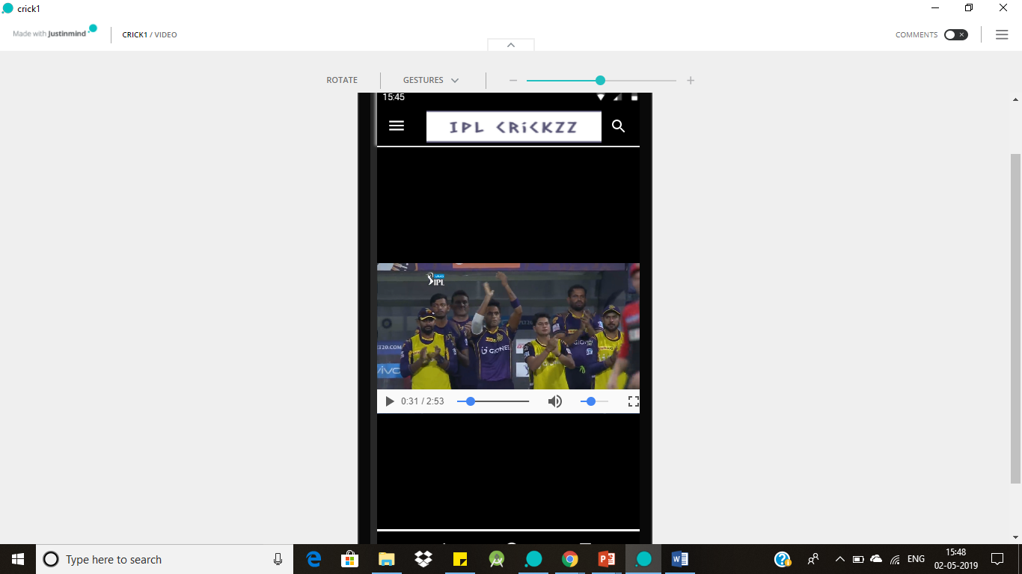
Videos Screen
In this screen application shows all the videos related to match reviews, Highlights of the match and also reviews of the cricket experts on the ongoing match.
User can easily switch from one video to another just by clicking on the video.

Slide 5
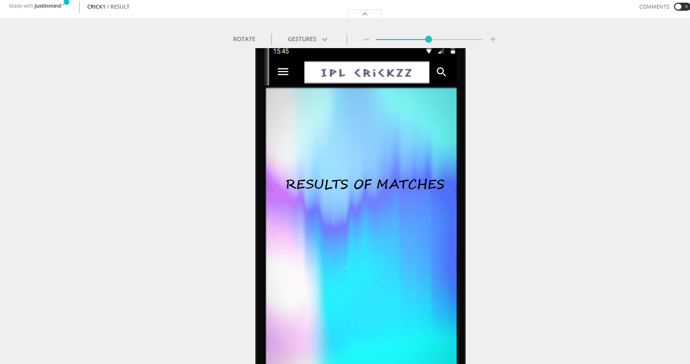
Results Screen
This screen shows all the results of the matches in the league and it clearly gives a summary of the match i.e., clear description of scorecards of both the teams.

Slide 6
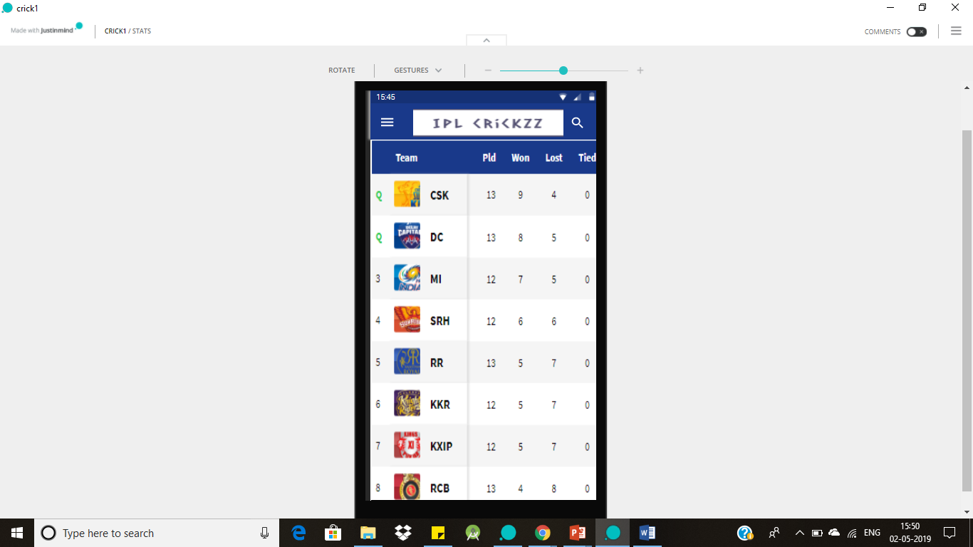
Points Table Screen
After the result of every match this page will show the position of every team in the league.
This screen gives the information to the user that which team is leading in the tournament and what are the teams going to clear playoffs all the information is recorded in the Points table screen.

Slide 7
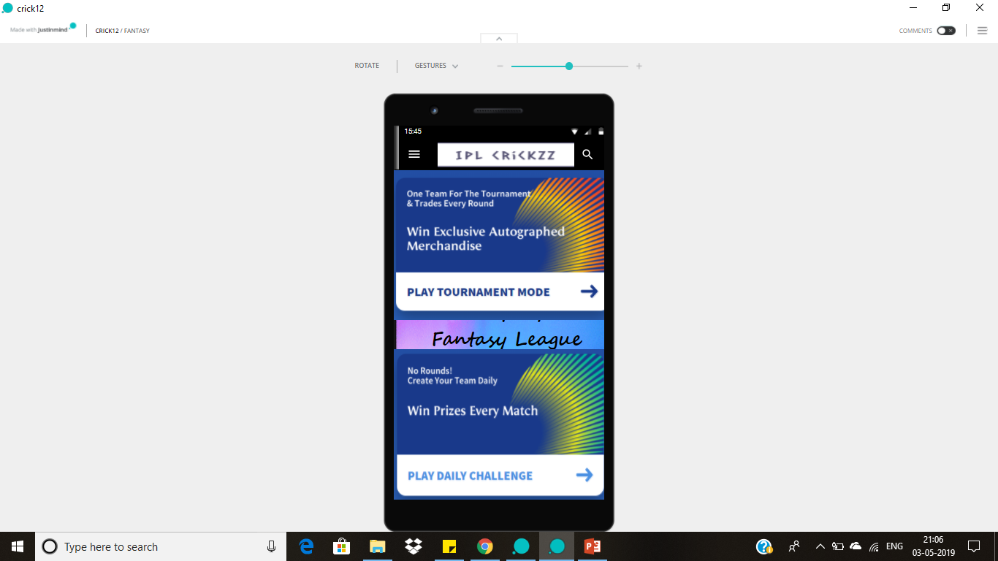
Fantasy Screen
In this screen user can earn points by participating in the fantasy league and also user have multiple options to participate in the league.

Slide 8
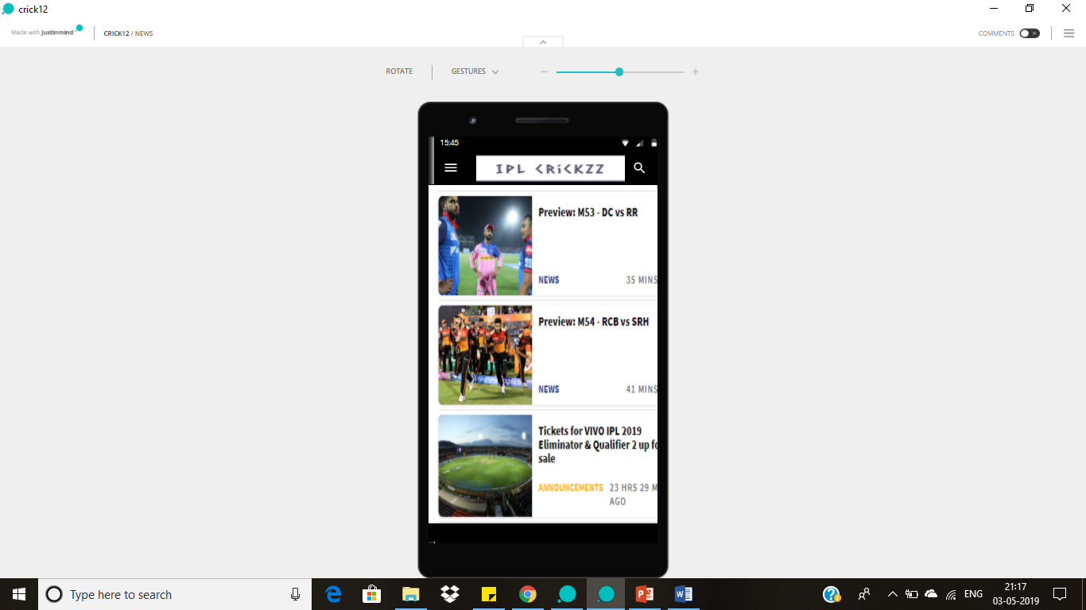
News Screen
This screen provides the information regarding the upcoming matches in the league and also the match reports of the league.
This screen also provide the information of Probable XI of teams before match starts.

Slide 9
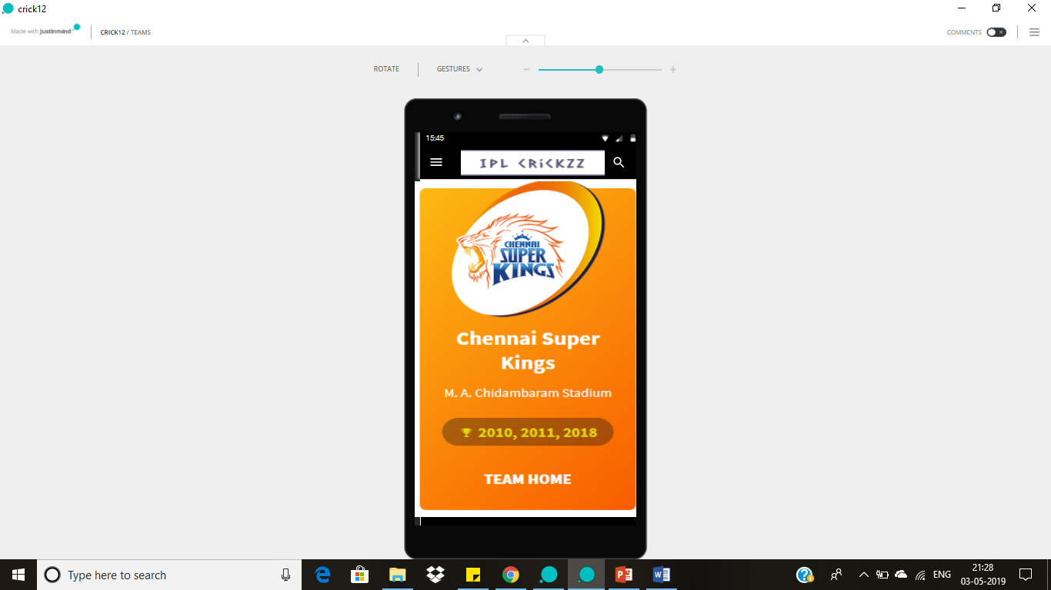
Teams Screen
In this screen user will be able to see all the teams participating in the league.

Slide 10
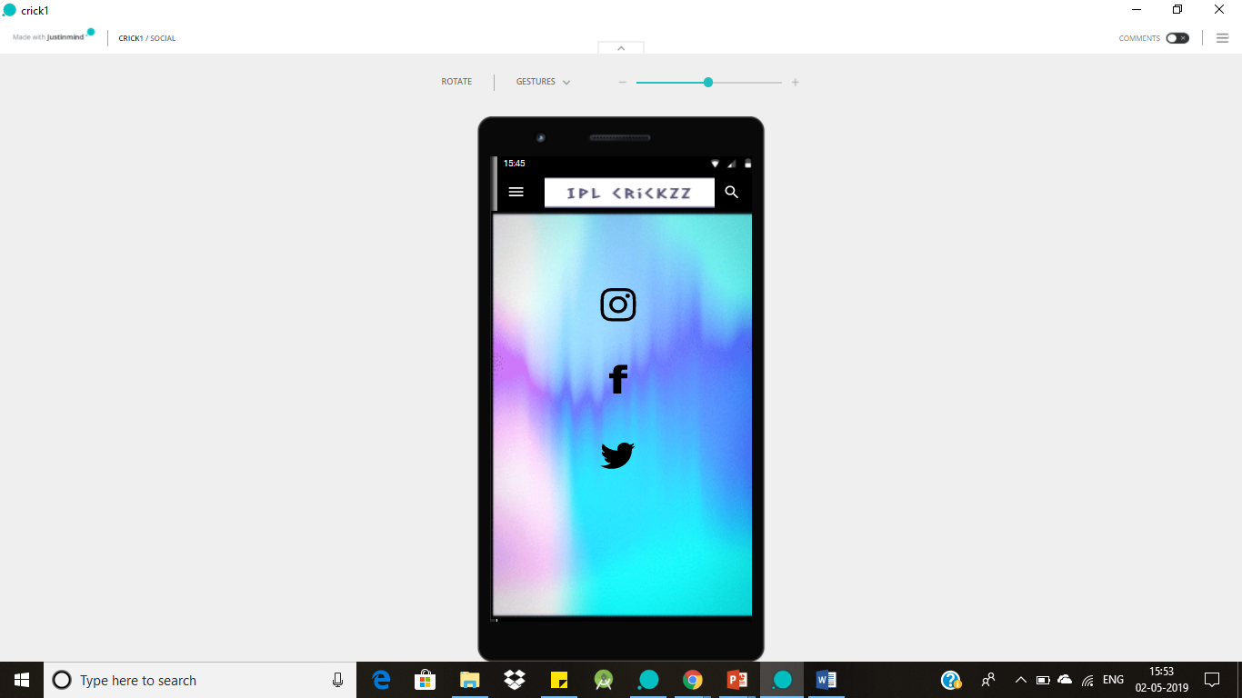
Social Media Screen
The internet changed the way people interact with each other as well as work culture, and those changes first arose on social media sites. That is why social networking sites are so important.
This screen intimates the users to follow the application in all the mentioned social networking sites for new updates of the application.

Slide 11
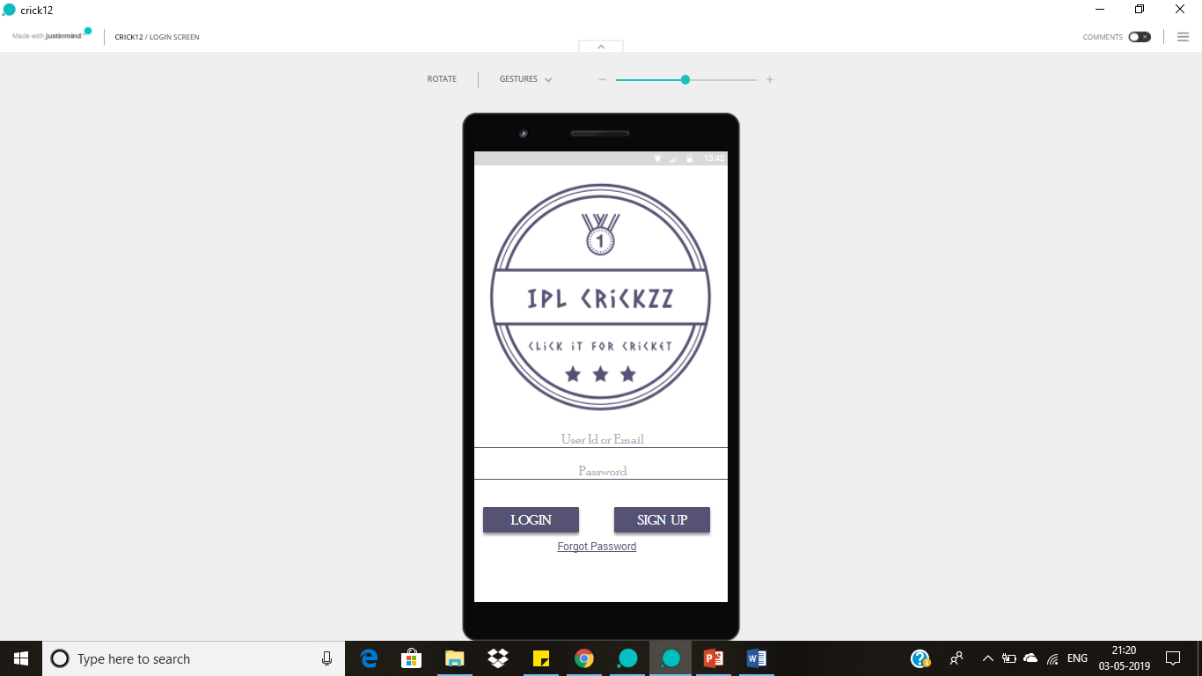
Logout Screen
On clicking the logout button in the menu bar user is able to logout from the application.

Slide 12
THANK YOU

